Slide 1

CyberBasics
A 6 part story for year 7 investigators

Slide 2
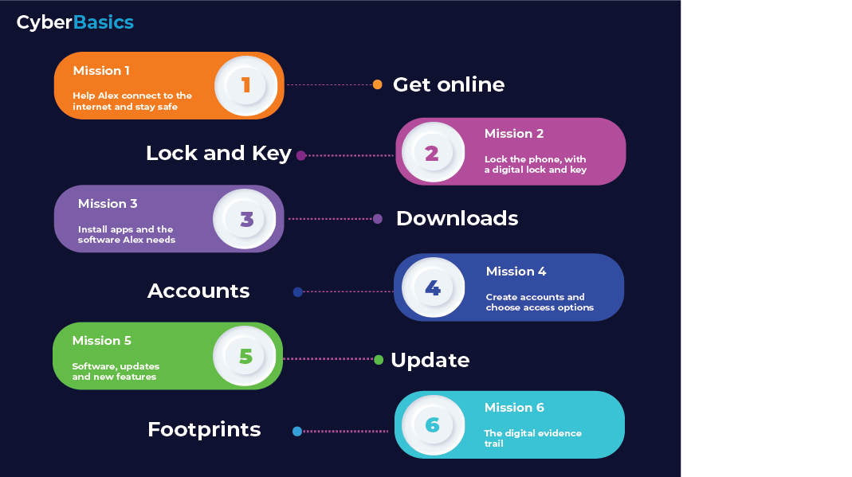
Session 1’s Group discussion
What are you going to advise Alex to do when connecting to the internet, or out in public, if keeping safe from snoopers is his main worry?
Notes:
Here the students can discuss what they found.
But they need to conclude with some good advice for Alex.
Mainly Public wifi is to be avoided.
You don’t know who owns it. People can pretend to be household brands, there are no rules. Some even copy the real brand’s password so they look the same.
Some students may bring up device encryption, VPNS and apps that encrypt all content but this is all good for them to talk about, but isn’t the main learning point.
Some may look at the law of illegally obtaining peoples data. There are a lot of laws here.

Slide 3
CyberBasics
Mission 2
Notes:
Authenticating yourself to your own device is all about how you determine how you want prove to your device you are you say you are! Just getting that concept across is the key to this section, as there are a lot of options, esp if you want to balance privacy against ease of use. That is often a very personal choice.

Slide 4


Alex continues to set up the phone
After session 1, Alex’s phone is now connected to the internet, following your advice
Now we need to look at the options around locking the device from anyone who may get their hands on it.

Slide 5
What would Alex need to think about?
Who is Alex most likely to want to keep out?
What could happen if someone had free access to an unlocked phone?
If someone had someone else’s phone, could they pretend to be them on that phone?
Could they lock access to accounts?
Could they see any stored passwords?
Notes:
Here is where the students look at the potential impact if someone had free access to their phone.
This isn’t really about all the different ways the student’s can lock a phone/device, its that they see the importance that they make it difficult for people who may not play nicely if they did “find their phone” and manage to gain access to accounts and settings.
The analogy is leaving the front door unlocked – if you were going out/away, would you lock the house door or leave it open? The same is true of the phone, just make it hard for those with bad intent to gain access – and have other defences too, but we’ll get onto those later in the story.
Passwords resets are a big thing for the students to consider. They are often done via email, so anyone with access to that account has a lot of mischief opportunities.
Or reputational damage if naughty people posted bad stuff on their social media channels. Hard to prove it wasn’t you etc. Kids do care about their online personas, so this could be a great chance to engage on something they so care about.

Slide 6
Your Second Mission!
Alex needs to know what the best options are
To prove to the phone that Alex is Alex digitally to gain access.
To make it difficult for others to digitally impersonate Alex or access things that are private
Your Mission is to research the risks of each option, as well as any other opportunities that may be of help in keeping Alex safe. You will then discuss the best options in the next session.
Notes:
Lets make it hard for people to access devices and the data and personal stuff we want to remain private. Digital IDs need protecting, as they become increasingly central to way of life.
If someone gained access to the Alex device, they could soon follow the digital clues to the physical identity.

Slide 7
Workbook Activities – Self-study
Things you may want to research / Google
All the different ways to lock a phone
Strengths and weaknesses of those lock techniques
Using more than one at a time
In Session 3, we will discuss your recommendations for Alex.
Notes:
Hopefully the students will know a little about
PIN Keylocks
Facial recognition/Fingerprints/Iris scanner – Biometrics
Swipe Patterns
Passwords/codes
In their own research time, they can look at what other people think are the best ways to lock a device. They may find how these can be bypassed too.

