Slide 1

CyberFirst
Adventurers
SPORTS SCIENCE Module

Slide 2
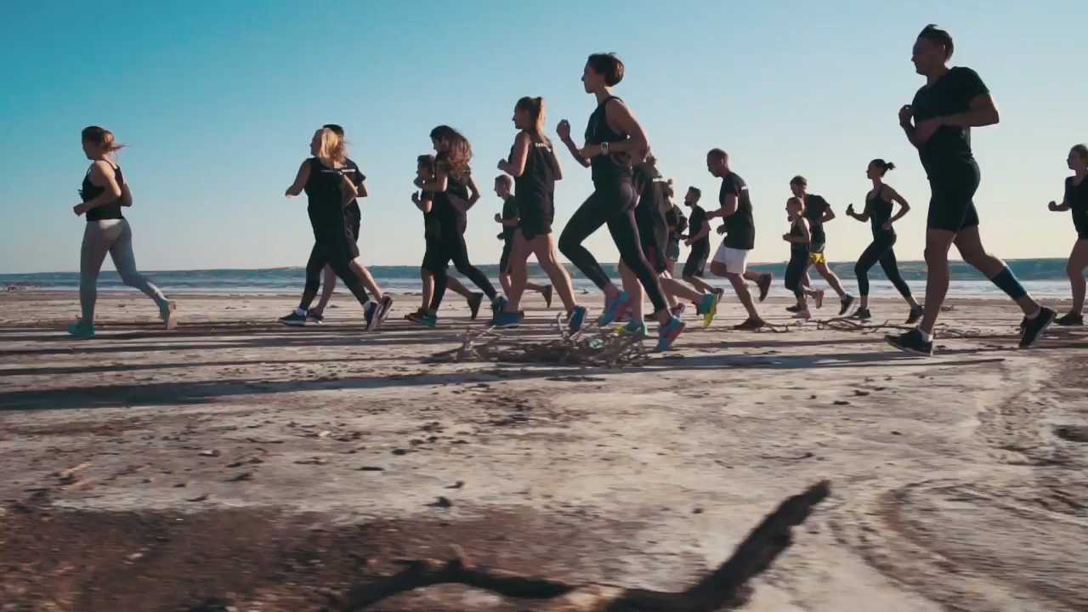
Technological Innovation in Sport

Slide 3

Module 4
SPORTS

Slide 4
Starter- Class Discussion
What sports are you interested in? (Playing or watching)
What data is used in sports?
Where can this information be used?
Notes:
Ask students what sports they’re interested in, either through playing or watching. Then using some of those examples (if any), ask what examples can they think of data in sport. They will hopefully come up with some examples like sports statistics (average goals scored per game/games won/percentage of game played in which area of pitch/existing sports records/lap or sprint times, etc.). Discuss where this information could be used, for example, trend analysis on components in an F1 car to help the team make decisions how to tweak the car for the next race, or knowing where an opponent has placed their last few penalties in order to help a ‘keeper save the shot, or knowing where a particular team is weak during the Tour de France in order to gain an advantage, or even (age-dependent) discuss betting, or choose something safer like the Premier League’s Fantasy Football game for a bit of fun – knowing that Harry Kane doesn’t score in August could help with some much needed points for people, etc. Explain that the use of data in sport has grown exponentially over the last few decades, many sports have embraced the use of data and technology to aid the development of their sport and the competitors within that sport.

Slide 5
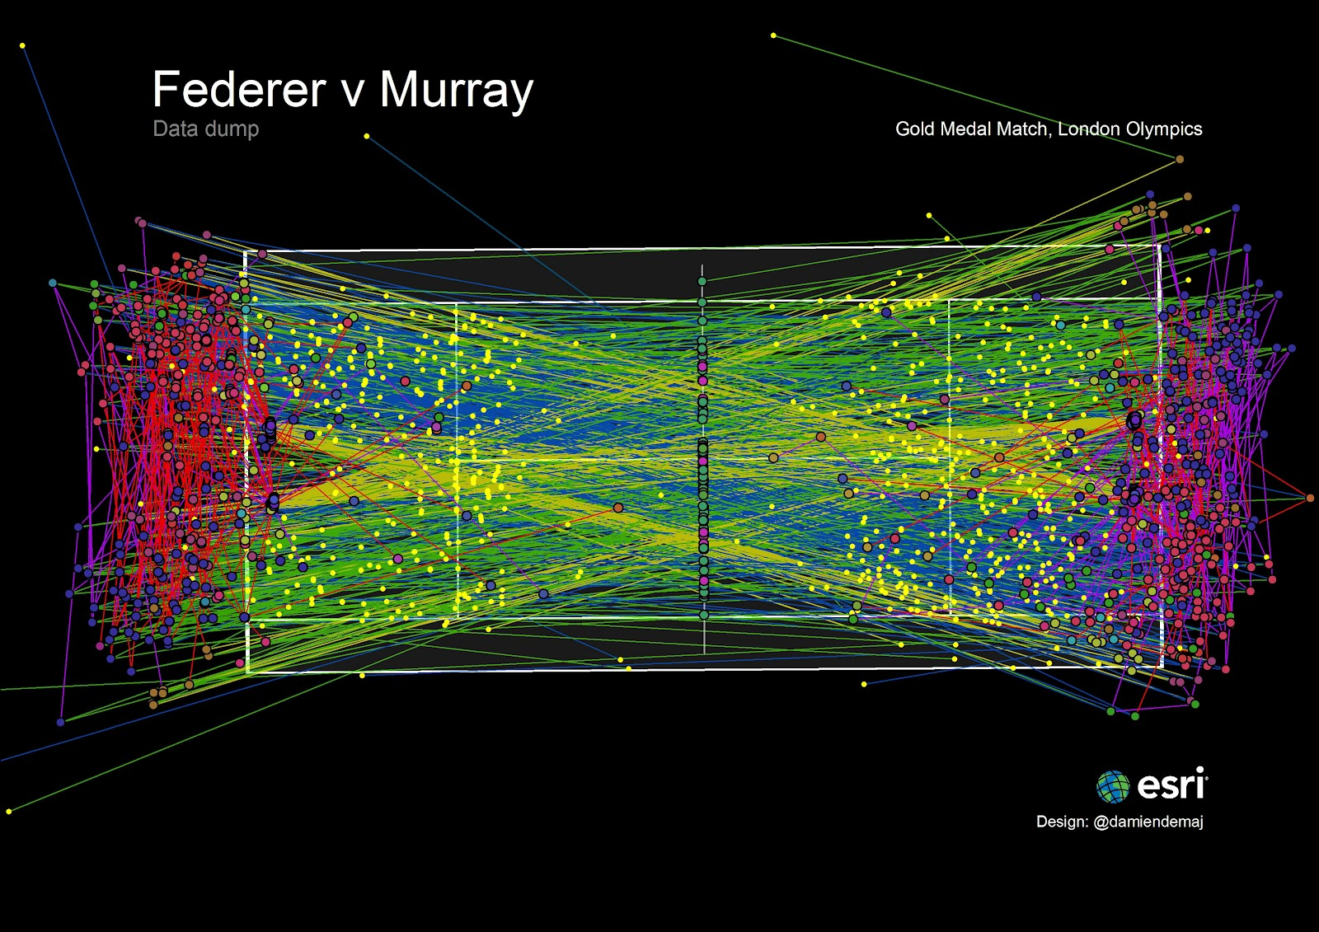
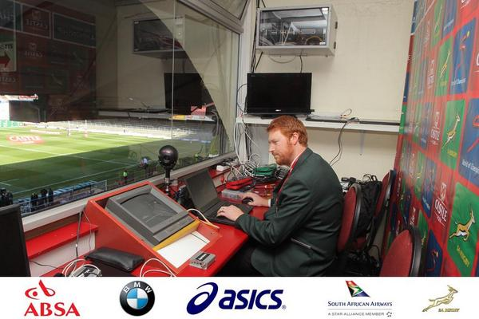
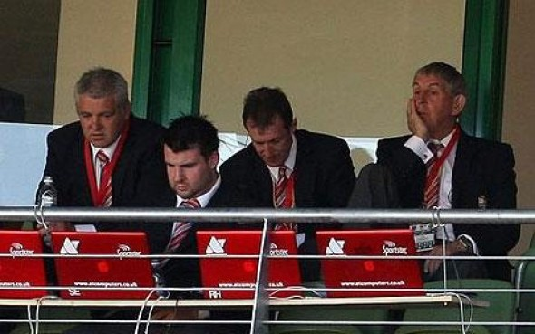
Cyber in Sport?
Notes:
Show the images, One and Three are displaying rugby analysis whereas Two is showing every shot during the Gold Medal match at the London Olympics in 2012.

Slide 6
Module Objectives
Understand how cyber can be used in sport
Understand the role of a data analyst
Use data analytics and logical thinking to help interpret data

Slide 7

LAB Quidditch Manager
Use data analytics and logical thinking to choose your Quidditch team.
Notes:
There has been an increase in the popularity of the game Quidditch, made famous in the Harry Potter series of books. There are national regulatory bodies in both the UK and the USA who produce the rulebooks and train officials. Due to the rapid increase in funding owing to recognition by schools and universities for this niche competitive sport, many people are looking to create or join a local Quidditch team to compete in the newly formed Quidditch Premier League (QPL). Data analysts have been busy creating a dataset of statistics for a large number of players who are new to the game and are attempting to catch a manager’s eye.
As a manager it is imperative to pick the best players possible, whilst also considering the players’ best position given their skillset.

Slide 8
Task – Working pairs
Open the dataset in Excel
Sort the data and use filter to help pick the best seven players for your Quidditch team (Use the video tutorial to help if needed)
Note the selected team on the worksheet provided
Notes:
In their pairs, choose the best seven players for their Quidditch team from the limited dataset (200 records) found the dataset.xlsx file in their Module 4 folder. Using the student guide as a reference and the video tutorial to help they need to select based upon the skills they feel are applicable to each position

Slide 9
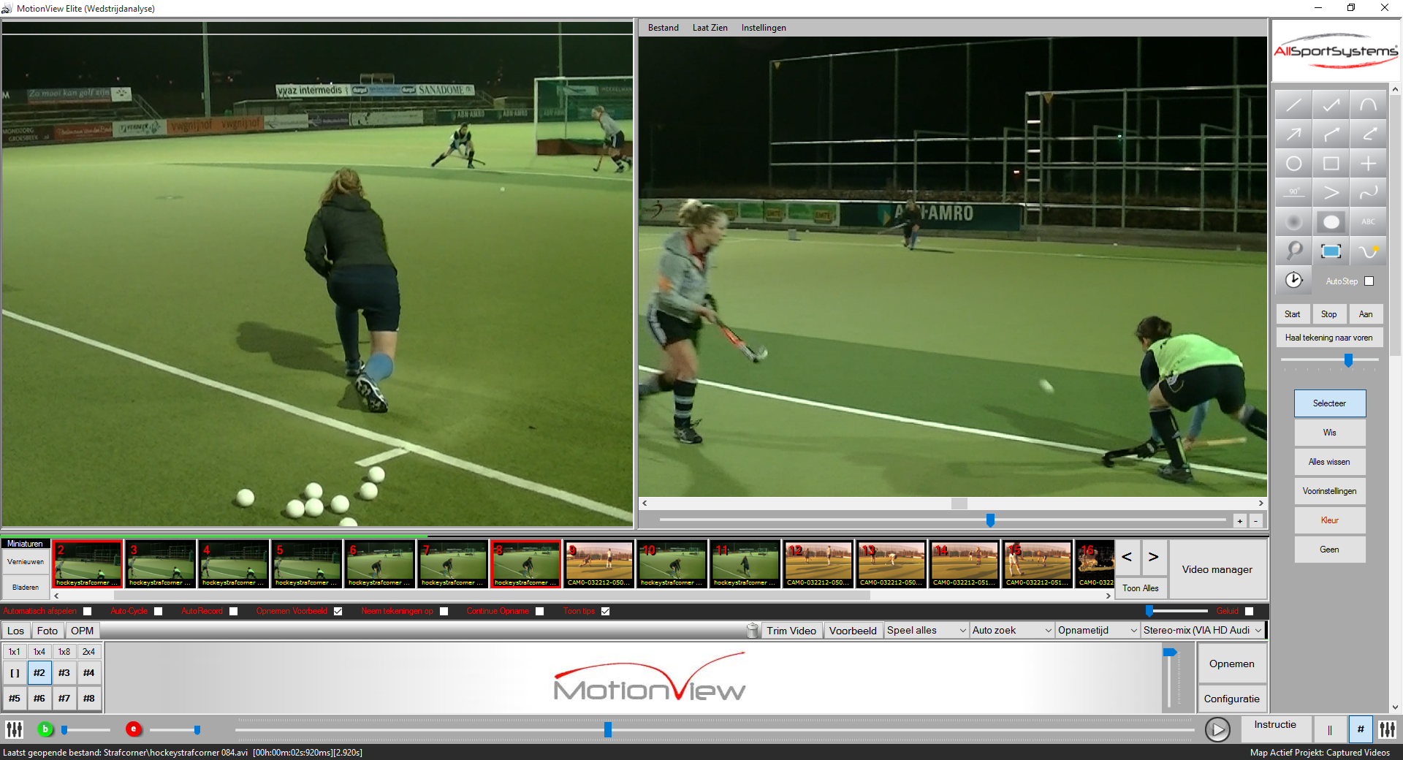
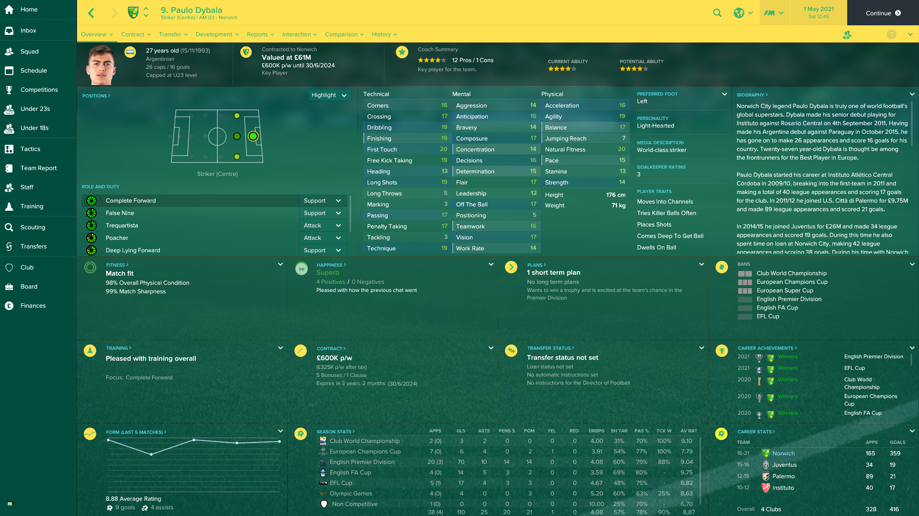
Summary
Notes:
Point to note for teacher– there is no right or wrong answer with this module, the whole point is that the team chosen by the students is down to their interpretation of the data given.
You could ask them how could we take this further? Maybe consider psychology within sport, consider how a player’s temperament may change depending on position chosen, external factors such as family, winning/losing streaks, etc. Maybe consider that although a player has a preferred position, they may be better suited to another position depending on their skills, how could that affect the team selection? Remind them that data analysis within sport is a massive growth area, including sports in games – for example the statistics gathered by data analysts working for the Football Manager [first image] series of games was used during the recent Sky Sports coverage of the transfer window to help clarify stats and to help the public understand a football club’s decision to sign or sometimes to release a player.
Technology is being used more and more to help gather statistics and data on player’s movements, either for motion capture for games/films, or for development purposes for that player or other players [second image].

Slide 10
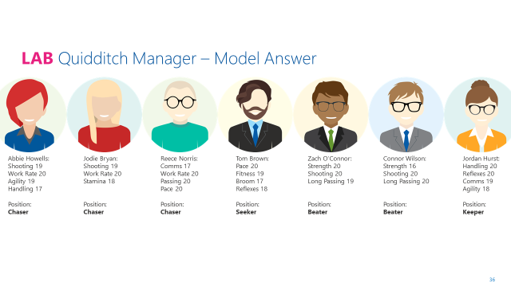
Model Answer
Notes:
The model answer that has been selected. This is extremely subjective and point out that this selection is based on the skills of each player, not their preferred position. Use this as a discussion point to introduce human factors in sport, sports psychology etc.

