Slide 1

Using AppShed
Lesson 3

Slide 2
Getting started
Each of the apps we write will need an icon and a splash screen.
Your icon will be square, and at least 150x150 pixels.
Your splash screen should be 320 x 480 pixels.
Both should be PNG images.
The next page has simple examples.

Slide 3


Getting started
Create a simple splash screen and icon.
You might want to create your own brand.
Your icon will be square, and at least 150x150 pixels.
Your splash screen should be 320 x 480 pixels.
Both should be PNG images saved in your Appshed folder.
You have 15 minutes to create your images.

Slide 4
Getting started
Log in to appshed.com using Google Chrome.
You should have your username and password from our last lesson.

Slide 5
Create a new app
You will need to:
Use ‘+’ to create a new App
Change your app’s name to App 3
Set category to education
Select your new icon – you will have to upload it
Select your splash screen – you will have to upload it
Top tip: you can choose fit or stretch at the bottom of the screen to make
your splash screen fit all devices
Change the header to show your name

Slide 6
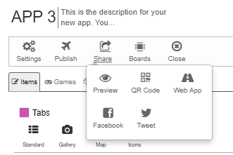
Testing your app
The fastest way to test your app is to Preview it:
Select the Share tab, and select Preview.

Slide 7
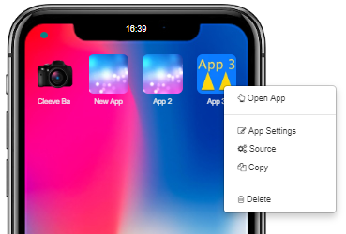
Getting back to edit your app
Click on the App 3 icon
Select Open App,
Then click once on app

Slide 8
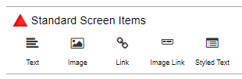
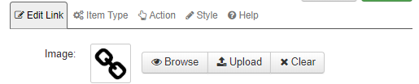
Let’s start some programming
We’ll start off by adding a typical ‘Hello world’ message to our app.
Use the Link button to add a link, and rename the link ‘Hello world’ .
Before saving, click on the ‘Action’ tab

Slide 9
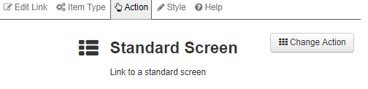
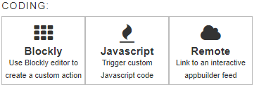
Adding actions
We will attach some Javascript code, using Blockly. Blockly looks like Scratch.
First, select Change Action
And select Blockly in Coding:

Slide 10
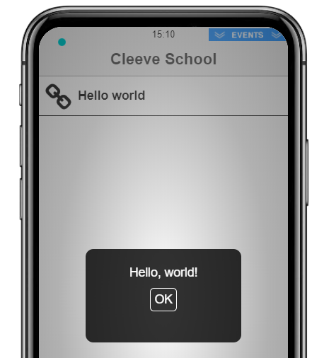

Make a message
Use the Javascript and Text tabs to make up a message like this:
Save the action, and then test your code. You can simply double click on the Link tab to test.

Slide 11
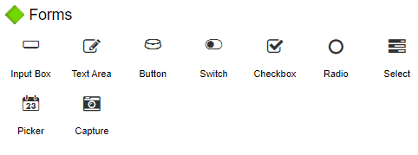
Let’s get some info off the screen.
Add an Input Box to your app, from the Forms area:
Change the Title to be Enter your name
Change the Name to be myname
This will create a variable called myname.
Save the input box.

Slide 12

On your own…
Add a button below the input box you just added.
Make the button’s label say ‘Greet me’
Click on action and select Blockly
Select alert text from Javascript
Look in App Variables and select the top block to make the following message:
What happens when you test?

Slide 13
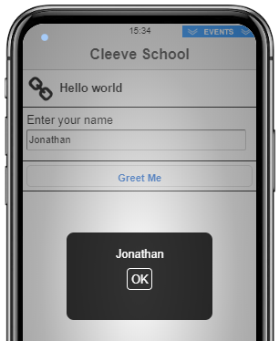
Result

Slide 14

Let’s make that look nicer
You may remember how we joined text together in Scratch and micro:bits.
In the Text tab of Blockly, we have can join our myname variable up to some text like this – try changing your code:
You will need the create text with to join, and the blank text block for your greeting.
Test it!

Slide 15
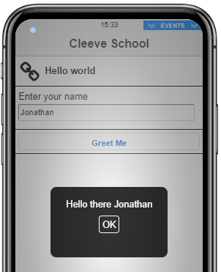
Result

Slide 16
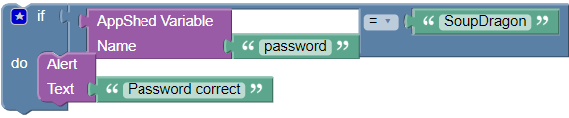
Adding a password
Add another text box with Title Password and Name password
Be sure to click the Password check box toward the bottom of the screen.
Check that anything typed in comes up as dots.
Add a new button called Passcheck, and click on Action. Select Blockly.
See if you can create the IF block below
LOGIC
TEXT
LOGIC

Slide 17
Write it up!
Open My Appshed Workbook from your own area, and fill in the pages for App 3.
Write as much as you can about your App and what you have learned today.

