Slide 1

Using AppShed
Lesson 5

Slide 2
Last lesson
Last lesson, you created a multi-page app with links to navigate around the different tabs. You also created a secure page that needed a username and password to enable a user to log in.
Most of your work was on your own.
Today, we will do some user contact forms and a bit more interface work.

Slide 3
Getting started
Log in to appshed.com using Google Chrome.
Hit the + to start a new App.
You should have your username and password from our last lesson.
You can add your own name (App 5) as well as your splash screen to the app.
Name the first tab created as ‘Main’. Put a picture on the page.

Slide 4
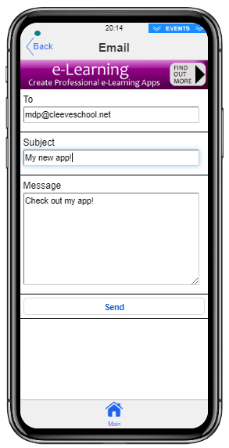
Getting in touch
Adding a contact us button is easy.
When you add a button to your page, you should be able to look at the buttons Actions tab and find that email is the default setting.
Set up the email details to come to your school email address.

Slide 5
That was easy – what’s next?
Add a new tab, and add the following:
Item | Title | Name
Input Box | Full Name | yourname
Input Box | Email Address | youremail
Checkbox | OK to email? | emailOK
Text Area | About me | aboutMe
Button | Submit

Slide 6
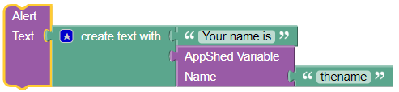
Now add some code
If you remember, we used Blockly code to deal with buttons.
Here is how we could output just one of the bits of information the user told us:

Slide 7
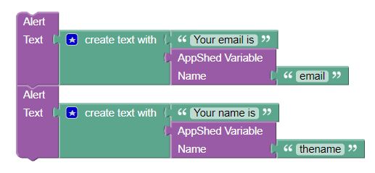
Joining code
You can join code like this:
Modify your code to output the name, email and about me fields.
Then, work out how to say whether emails are permitted or not.

Slide 8
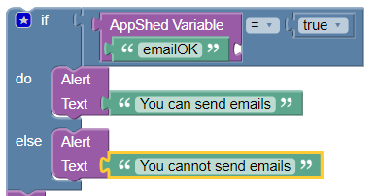
Emails permitted?

Slide 9
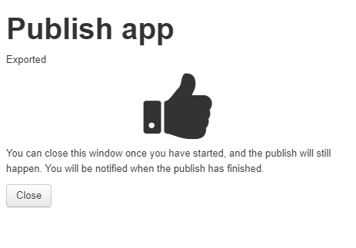
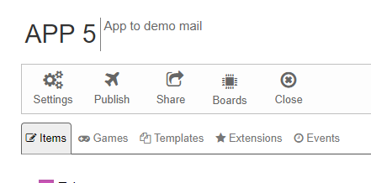
How to share
You will need to send a link to your teacher to test.
Select Publish and wait for

Slide 10
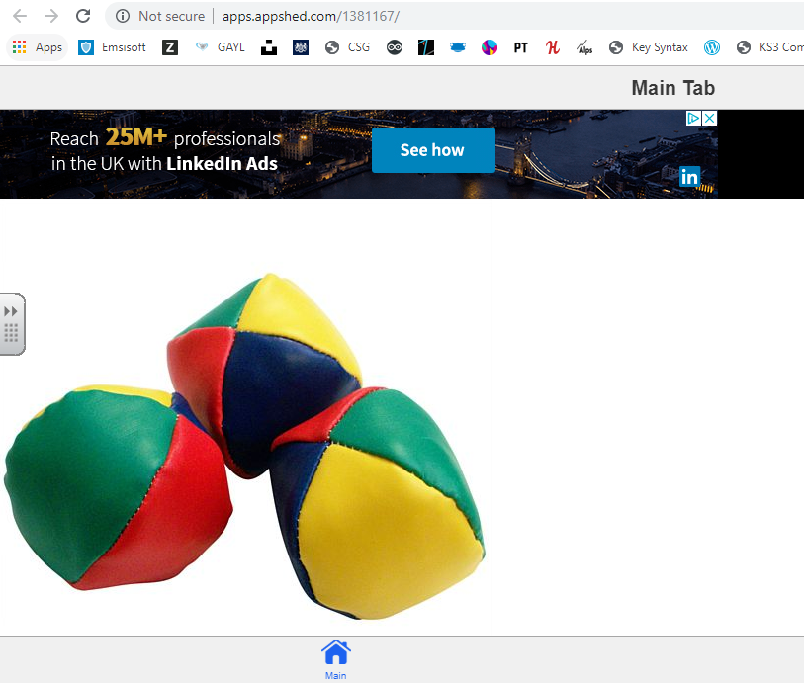
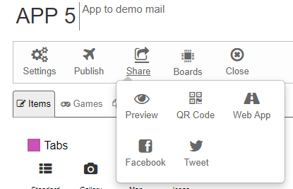
Then share:
COPY WEB ADDRESS!

Slide 11
Experiment time!
Add another page, and experiment with the remaining items you can use on your app.
Be adventurous – not a lot can go wrong!

Slide 12
Write it up!
Open My Appshed Workbook from your own area, and fill in the pages for App 5.
Write as much as you can about your App and what you have learned today.

