Slide 1

Using AppShed
Lesson 4

Slide 2




Last lesson
Last lesson, we learned how to add form components to our App, as well as icons and a splash screen.
We also added some logic using Blockly.
Today we will move between tabs.
To start off, make 4 simple icons, with numbers 1, 2, 3 & 4.
Size 200 x 200 pixels.
Save them as PNG files to your Appshed area as link1, link2, link3, link4
No more than 10 minutes!

Slide 3
Getting started
Log in to appshed.com using Google Chrome.
Hit the + to start a new App.
You should have your username and password from our last lesson.
You can add your own name (App 4) as well as your splash screen to the app.
Can you name the first tab created as ‘Main’?

Slide 4
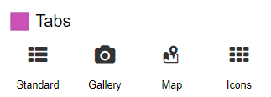
Add two more tabs
You can add more tabs using the Tabs area:
Add a gallery tab and a map tab. Use the five images you used in lesson 1 for the gallery, and put three pins into the map to show a school, a church and a shop in the local area.
15 minutes maximum!

Slide 5
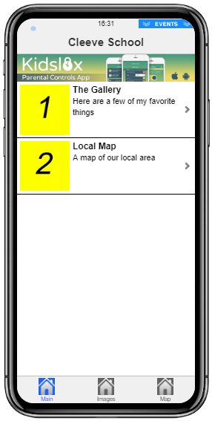
Let’s navigate!
Most apps have a quick way of navigating between tabs.
Edit your first tab, and use two Image Links to insert your icons, some descriptive text and some links to the other tabs.
You need to work this out yourself.
Top tip: in Action, you need to select Jump to a Tab
10 minutes should be plenty!

Slide 6
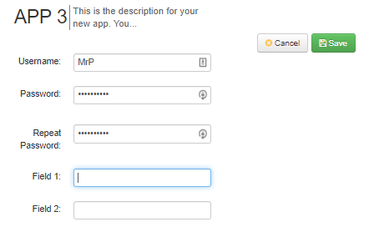
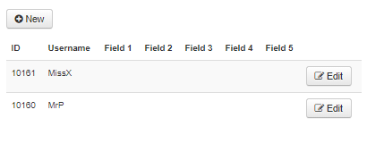
Getting secure
Sometimes we need to make sure our pages can only be accessed by valid users.
AppShed lets us do this.
Go to Settings and then Users, and add a couple of users. Be sure to keep a note of the usernames and passwords.

Slide 7
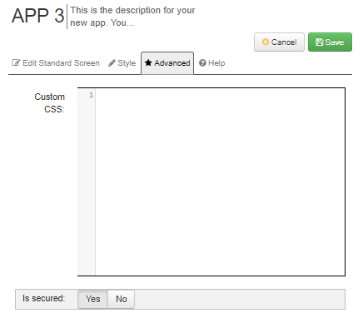
Add another tab
Just add a standard tab, and drop an image on it.
Call the tab Secret.
Change the title at the top of the Tab to Secret, and before saving, go to Advanced and change the Is Secured slider to Yes.
You will now have to enter a username and password before getting access to your page!
Can you remove the Register option?

Slide 8
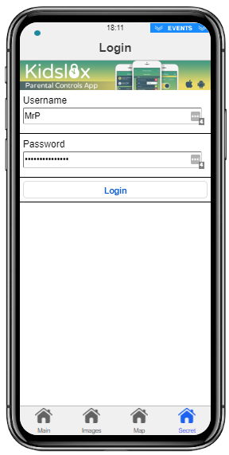
A Secure Page

Slide 9
Write it up!
Open My Appshed Workbook from your own area, and fill in the pages for App 2.
Write as much as you can about your App and what you have learned today.

