Slide 1

Using AppShed
Lesson 2

Slide 2
Getting started
Log in to appshed.com using Google Chrome.
Hit the + to start a new App.
You should have your username and password from our last lesson.
Then find five images of your five favourite things, and save them to your Appshed folder.
Rename them Fave1, Fave2 … Fave5.
You have 10 minutes.

Slide 3
About today’s lesson
Appshed has a lot of options for each of its functions. We will have a quick look on the board, then it’s down to you to experiment and find your way – that’s the challenge!

Slide 4
Adding Tabs
We will add a new Gallery tab to our app.
This is easy – just choose one in the Tabs section.
Give it a name and save it.
Can you work out how to add an image to the favourites tab?
Add all five of your images.

Slide 5
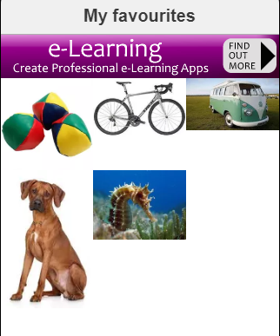
Here are my images
Why do they look a bit uneven?
It’s because my images are different sizes. If I made them all the same size they would look much better.

Slide 6
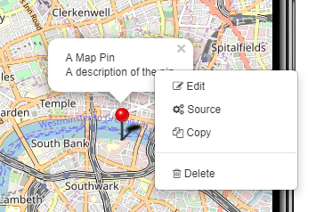
Moving on
You should have a main tab and a favourites tab.
Try adding a map tab. This will add a map point in London, which you can delete by slicking in the shoutout that appears when you click on the pin.
Add pins for home, school, Tesco,
St Michael’s church, Tewkesbury Hospital
and Cheltenham racecourse.
Then add four more pins of your choice.

Slide 7
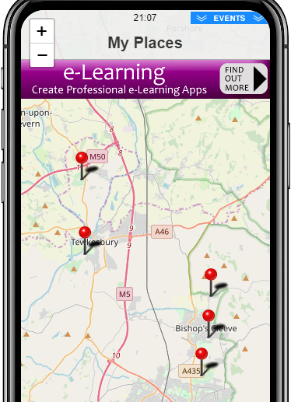
Example Map

Slide 8
About me
Add a ‘standard’ tab – this is a blank one. Call it about me, and build up the content to tell people about your interests. Don’t give too much away!
You can use the screen items to add images and more – be creative!

Slide 9
Write it up!
Open My Appshed Workbook from your own area, and fill in the pages for App 2.
Write as much as you can about your App and what you have learned today.

Slide 10
Extension
Find out how to publish your site.
When it is published, go to Share and test your site with Preview.
Does it work?
Are all your tabs labelled, or do you need to go back and change them?

