Slide 1

CyberBasics
A 6 part story for year 7 investigators

Slide 2
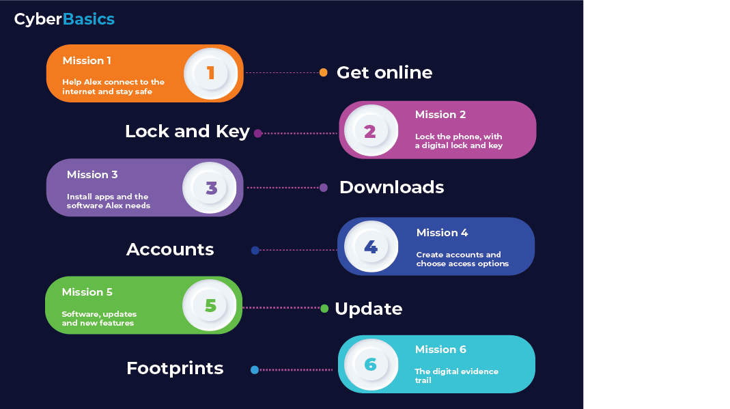
Session 4’s Group discussion
What are you going to advise Alex to do when creating and protecting accounts?
Notes:
Here the students can discuss what they found.
But they need to conclude with some good advice for Alex.
Hopefully lots around passwords complexity/uniqueness, as well as MFA on key accounts.
Not all accounts need total honesty either. Did students think about this. For example, why give a real DoB to an account that doesn’t need it, other than for marketing reasons? Is that legal? What did they think. And what will they tell Alex, considering the lack of accurate alien birth info……
Actual postcode? House Number? I hope they think about that too.
Accounts give ease of use and access, but are a risk too. So balance it.
Did the students look at Defence in Depth, or what Chat GPT thought about it (on the resource sheet).
Did the identify key accounts that needed extra protection, like email.

Slide 3
CyberBasics
Mission 5
Notes:
This is about the software development life cycle.
Software often has bugs, these get found, and then fixed.
That is often why updates appear, also called fixes or patches.
Its normal.

Slide 4


Alex continues to set up the phone
After session 4, Alex’s phone now has accounts and access controls
Now we need to look at the options around software updates
Notes:
This Mission is about instilling some understanding that software is often never totally safe. Things need fixing as they are discovered, and this is normal.
Some fixes are more urgent than others, as they have vulnerabilities that can be exploited by hackers.
So essentially the students get to understand why they need to update software and why.

Slide 5
What would Alex need to think about?
Why does Alex need to update software that’s just been installed?
Are updates just new features and options?
Who is interested if you are running old software?

Slide 6
Workbook Activities – Self-study
Things you may want to research / Google
How do you know there is an update? Who sends them?
Why does software need all these updates?
What are software vulnerabilities?
In Session 6, we will discuss your recommendations for Alex.
Notes:
The students can look at auto updates, as well as where updates come from a trust perspective. Random emails and links are not to be trusted at face value.
The students may look at how hackers exploit vulnerabilities, such as making software do things its not supposed to.

