Slide 1

CyberBasics
A 6 part story for year 7 investigators

Slide 2

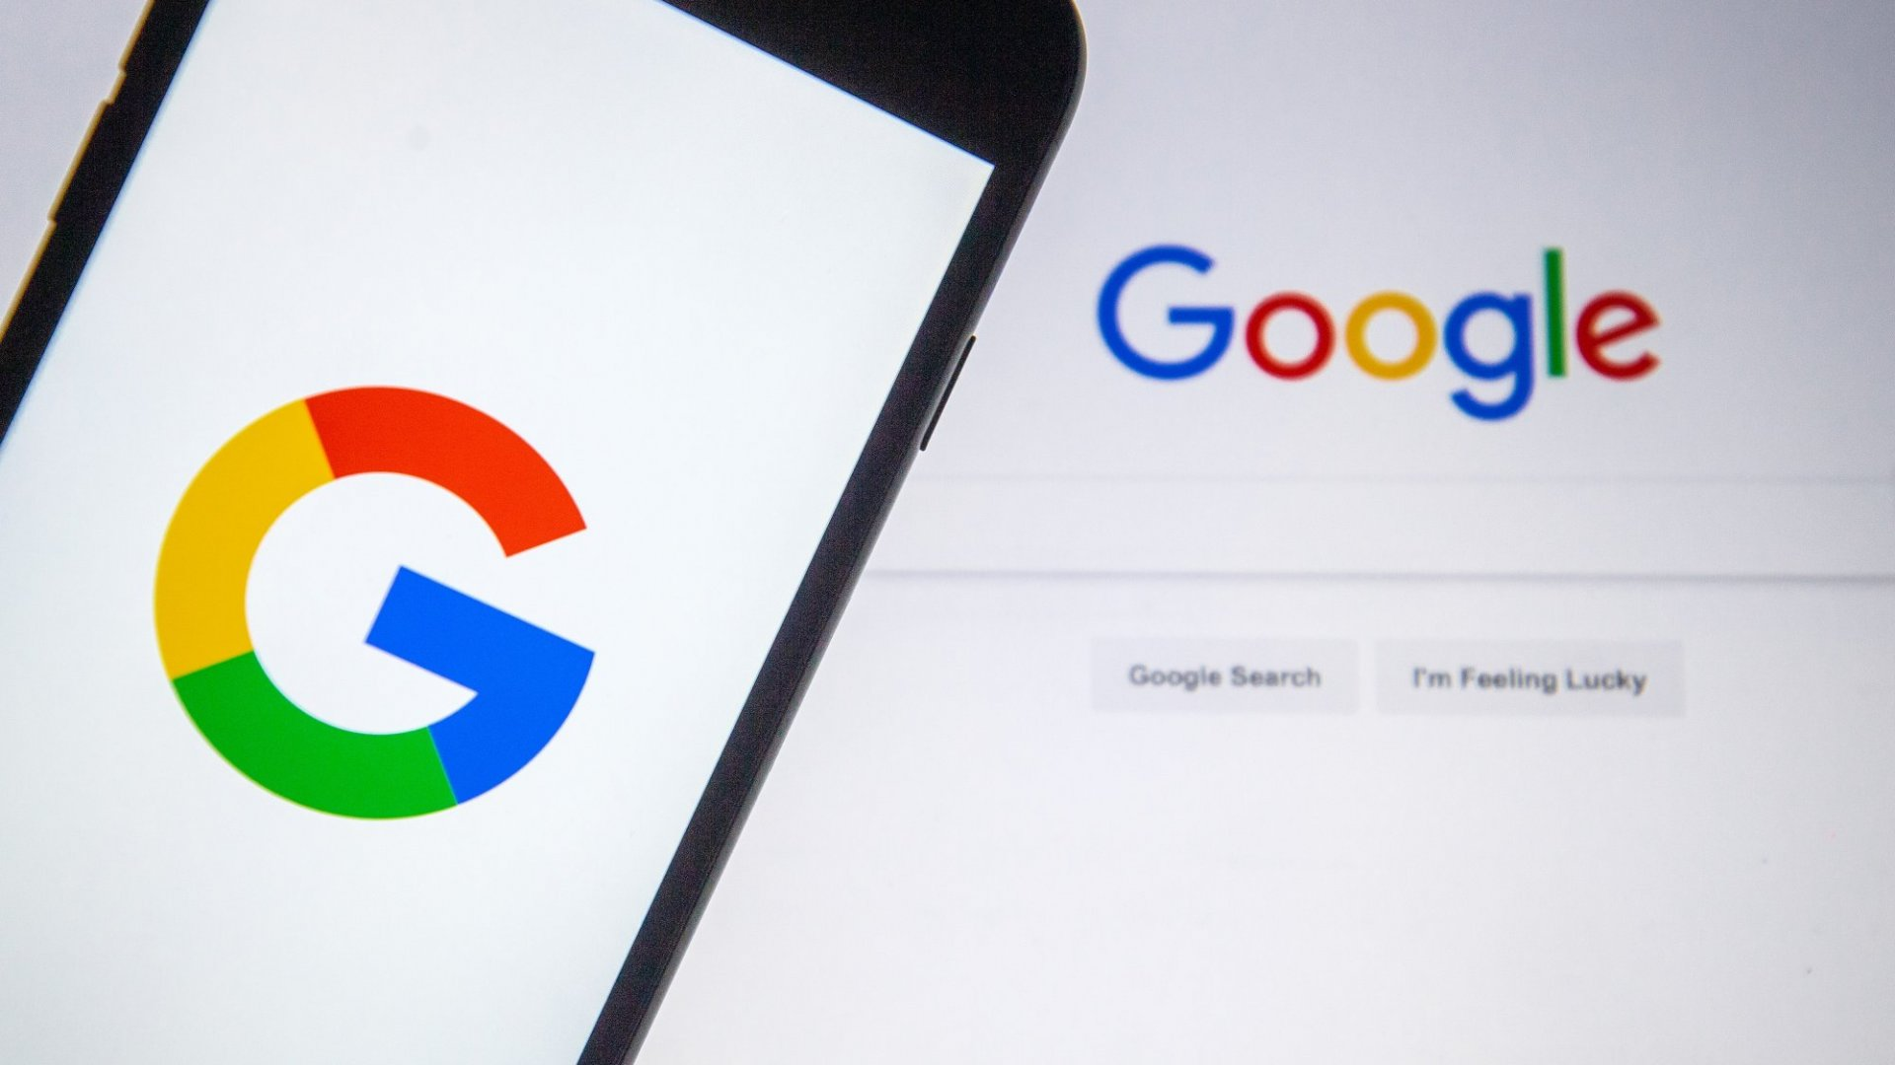
what’s this INVESTIGATON all about?
Our cyber story
We have an Alien visitor, Alex, who wants to learn how to use a mobile phone, as well as how to avoid being found while here
  You get to advise Alex on how to set up a new mobile phone
  You get to research choices to keep Alex from being found
  You get to share any thoughts on how best to do that
  So your favourite video channels & feeds are your friends
  here – & no tests!
Notes:
TEACHER NOTES:
This is the set up for the first of 6 episodes.

Slide 3
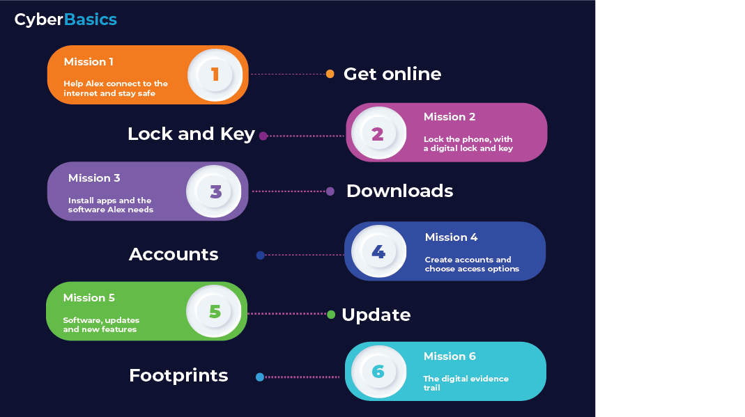
Notes:
TEACHER NOTES:
This is the set up for the first of 6 episodes.
Here are the 6 planned sessions.

Slide 4
How does CyberBasics work?
We introduce a new Mission every session
You then investigate options in how Alex sets up the phone
You report back your findings for group discussion, and then start the next mission
Notes:
The is all about instilling confidence in the students undertaking self led research as well as contributing to discussions on what they have found are the key takeaways here
The main first mission is all about their understanding that the internet is not inherently safe, just because it has always been there. It should help them to understand that there are precautions that anyone can take, to avoid unwittingly being a victim, if they take the time to look at the options.
The story covers the essential steps in turning on a phone for the very first time, researching some of the potential perils, and advising the alien on how to mitigate the potential threats.

Slide 5
CyberBasics
Mission 1
Notes:
Getting an idea about what data sources are that allow access to the Internet, via different technologies, is the principle objective of this lesson.
Hopefully the idea that wi-fi is everywhere will also be challenged as the students learn more.
Wi-Fi vs data roaming are the 2 things to be aware of when choosing how to access the internet
Mainly wi-fi has 2 things to consider
public
and private
both accessed via the wireless/wi-fi icon on a phone
Roaming Data, accessed via your phone network, is not just the choice when cost or lack of wi-fi is a consideration. When conducting things you really don’t want others to be able to see, such as banking and other financial transactions, data may be a lot more secure.

Slide 6

What could happen if we connect to someone else’s Wi-Fi?
Notes:
TEACHER NOTES:
Indicative time for this activity: 5 min.
First choice of video, there are 2, feel free to use this one or the second one.
Video – Security Dangers of Public Wi-Fi
Use the video to spark interest about the dangers of connecting to unknown Wi-Fi networks.

Slide 7

Is Public Wi-Fi Safe?
Notes:
TEACHER NOTES:
Indicative time for this activity: 5 min.
Use the video to open a discussion about the dangers of using Free Wi-Fi Hotspots/Public Wi-Fi.

Slide 8


Introducing our ALIEN, Alex
Alex has travelled from a planet far away, to see the sights on Earth
Alex suspects there are others of his race already here, so doesn’t want to be found and sent back
The first thing that’s needs to be done is to help set Alex up with a new phone
Alex has never used the internet before, or a phone, so you are going to be advising him on all the things that need doing to avoid being discovered.
Notes:
I’ve used a gender neutral entity, the Alien, for the students to try to protect over the 6 sessions. Feel free to give it a gender term if that works better for you.
Alex doesn’t want returning to the alien home planet, hence needs to choose cyber potions that mitigate that threat. Alex needs to make decisions that are a little more security focused than the students probably would for their own devices, but it gets them taking on that responsibility in their decision making. We want them safely exploring options without them thinking only in their own contexts.
By getting them to take some responsibility for helping a complete stranger (an alien) to connect to the internet, they can perhaps approach this from a 1st principles perspective. Peer learning and support rather then being told what to do? Tech usage is often about making risk related choices, so how to we start to instil that mindset?
And learning can work best when you have to learn how to then teach it – which is the students’ role here – teach Alex how to do this.

Slide 9
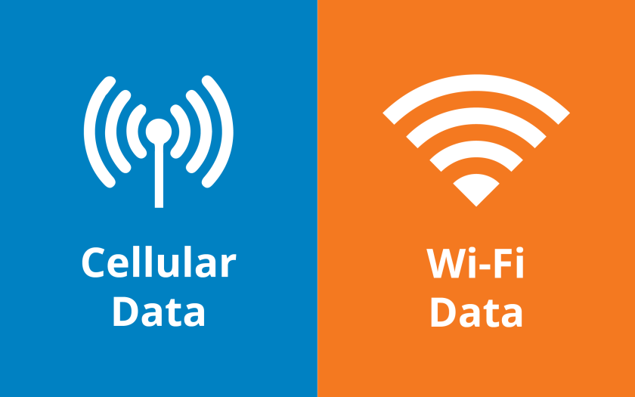
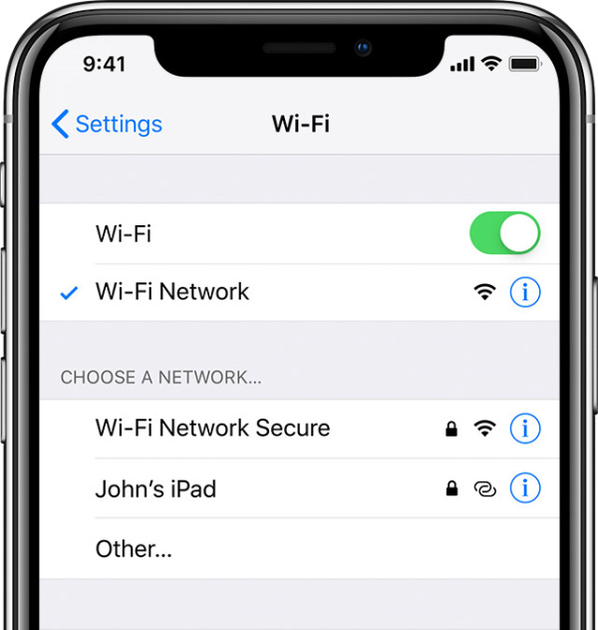
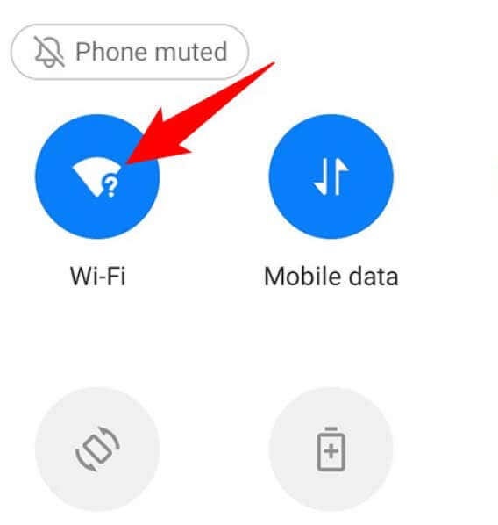
What would Alex need to think about?
What are the best options to keep Alex’s internet private?
What do these icons mean?
Is there anything Alex needs to worry about when choosing one?
Notes:
Many students may be aware of free to them internet as the only consideration about what to connect to, when away from home Wi-Fi.
Some may have data allowances on phones too, limiting the option to roam as it would soon incur charges, or run out!
This topic is about their assuming that all free things are safe, or that cost should be their only consideration.
While mobile data is the safest by far, it may not be an economic option.
I would like them to at least be aware of what risk public Wi-Fi can be to them, if just as an awareness piece.
Public Wi-Fi can be spoofed or imitated – called rogue hotspots or access points – by anyone anywhere. Trusting a network because it has a familiar name is the thing we would like them to be suspicious of.

Slide 10

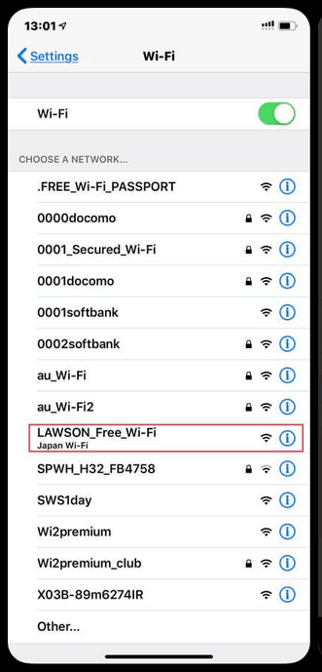
Class Activity – How do you use Wi-Fi?
Make a list of the most common locations where you regularly use password protected Wi-Fi
Do you use Free Wi-Fi Hotspots?
If yes, how do you know who owns the Free Wi-Fi Hotspot?
Notes:
TEACHER NOTES:
This is a bit of an ice breaker, to get the students to open up a little when talking about tech.
Ask each student to make a list of locations where they use secured Wi-Fi on a regular basis:
Home
School
Friends’ or Relatives’ home
Ask the class to list any venues where they are using Free WiFi:
Shopping Centres
Hotels
Airports
Public Libraries
McDonald’s
Coffee Shops
Give them a few minutes then when everyone finished their lists, poll the class on which most common locations they regularly use WiFi.
Use this to open up a brief discussion about Free (also known as Public) WiFi Hotspots. If anyone said that they are using Free WiFi Hotspots, ask them to explain how do they know who owns those hotspots.
Most of them will say that the name of the WiFi network will indicate who the owner is: i.e. a hotspot named “McDonalds_FREE_WiFi” in a McDonald’s venue is owned by McDonald’s.
But this might not always be the case. Use this to segway to the next slide where a video will show the dangers of connecting to Free WiFi Hotspots.

Slide 11
Your First Mission!
Alex needs to know what the best options are
To connect to the internet on any type of phone.
But without exposing his identity here on Earth
Your Mission is to research the risks of connecting to the internet, as well as any other technologies that may be of help in keeping Alex safe. You will then discuss the best options in the next session.
Notes:
This sets the scene for why the students are doing what they are doing.
The type of phone and software rrunning on it doesn’t matter, be it Apple or Android or anything else! This is about the students finding their own way and research interests.

Slide 12

Workbook Activities – Self-study
Things you may want to research / Google
Mobile data networks (also called Cellular networks) vs Wi-Fi
Wireless padlock icons
Public Wi-Fi risks
Other technologies that may help Alex
Notes:
TEACHER NOTES:
The students may look at the public wifi risk, or look at secure options like vpns. Your role as the teacher is to allow them to explore. There are no right answers here at the end of the day, as security can be achieved in a variety of ways.

